Slide 1
Justice:
Resolution 3c
THE PHBF STORY:
Who We Are &
What We’re About

Slide 2
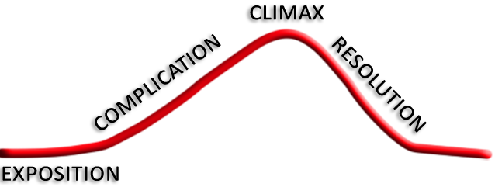
The PHBF Story
BIBLE: Story
GOSPEL: Plot
JESUS: Hero
MISSION: Resolution 1
GROWTH: Resolution 2
FAMILY: Resolution 3a
CHURCH: Resolution 3b
JUSTICE: Resolution 3c
THE CROSS
THE KINGDOM
THE FALL
CREATION
Who We Are & What We’re About JUSTICE

Slide 3
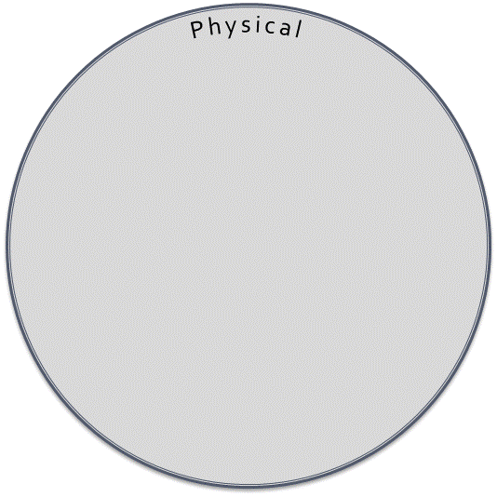
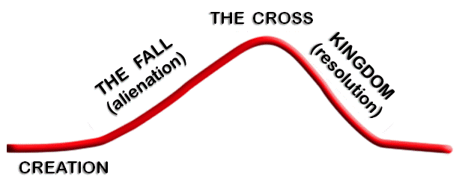
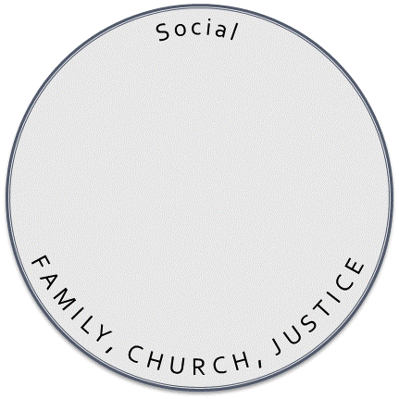


Alienation vs. RESOLUTION
MISSION: Resolution 1
GROWTH: Resolution 2
FAMILY: Resolution 3a
CHURCH: Resolution 3b
JUSTICE: Resolution 3c
Who We Are & What We’re About JUSTICE

Slide 4
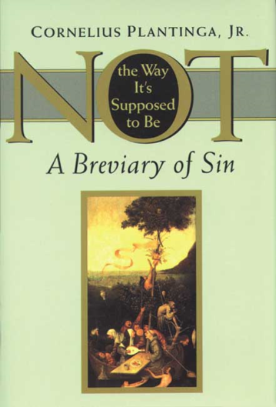
The Meaning
The webbing together of God, humans, and all creation in
justice, fulfillment, and delight is what the Hebrew prophets
call shalom. We call it peace, but it means far more than
mere peace of mind or a cease-fire between enemies. In the
Bible, shalom means universal flourishing, wholeness, and
delight — a rich state of affairs in which natural needs are
satisfied and natural gifts fruitfully employed, a state of affairs that inspires joyful wonder as its Creator and Savior opens doors and welcomes the creatures in whom he delights. Shalom, in other words, is the way things ought to be.
~ Cornelius Plantinga, Not the Way It’s Supposed to Be
Who We Are & What We’re About JUSTICE

Slide 5
The Meaning
Two reasons this definition of "justice" matters:
It validates the Christian story.
It explains Jesus' ministry. (cf. Lk 7:20-22, 9:1-6)
Who We Are & What We’re About JUSTICE

Slide 6
The Recipients
Is not this the fast that I choose: to loose the bonds of wickedness, to undo the straps of the yoke, to let the oppressed go free, and to break every yoke? ⁷ Is it not to share your bread with the hungry and bring the homeless poor into your house; when you see the naked, to cover him, and not to hide yourself from your own flesh?
Isaiah 58:6-7
Who We Are & What We’re About JUSTICE

Slide 7
The Time
"You are the light of the world. A city set on a hill cannot be hidden. ¹⁵ Nor do people light a lamp and put it under a basket, but on a stand, and it gives light to all in the house. ¹⁶ In the same way, let your light shine before others, so that they may see your good works and give glory to your Father who is in heaven.”
Matthew 5:14-16
Who We Are & What We’re About JUSTICE

Slide 8
The Motivation
So Jesus also suffered outside the gate in order to sanctify the people through his own blood. ¹³ Therefore let us go to him outside the camp and bear the reproach he endured. ¹⁴ For here we have no lasting city, but we seek the city that is to come. ¹⁵ Through him then let us continually offer up a sacrifice of praise to God, that is, the fruit of lips that acknowledge his name. ¹⁶ Do not neglect to do good and to share what you have, for such sacrifices are pleasing to God.
Hebrews 13:12-16
Who We Are & What We’re About JUSTICE

